Slide 1

Test Plan Creator
Shweta B
Chethan Kumar G

Slide 2
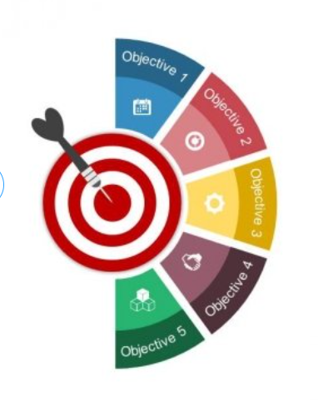
Objective:
Test Plan Creation
Adding Test Cases/Suites
Adding Test Environments
TCER Creation
Fetching Test Plan ID and creation of reports

Slide 3

Design

Slide 4
Design
Login to RQM
Logout from RQM and send a mail with required data
Create New Test Plan
Enter Test Plan details [Solution/Release etc.,]
Add Test Cases if CR available or add Test Suites accordingly. [If failed to add Testcase/Test Suite , the data is written into output file.
Add Test Environments
Search for Test Plan
Launch existing Test Plan , if already exists
Create TCER for test cases/suites as required.
Notes:
Selenium with Java as a language.
Scripted for Chrome
We’ve used POI [ an apache API ] to read data from excel sheets
And have used JavaMail API to have the mails sent accordingly.

Slide 5

Demo

Slide 6
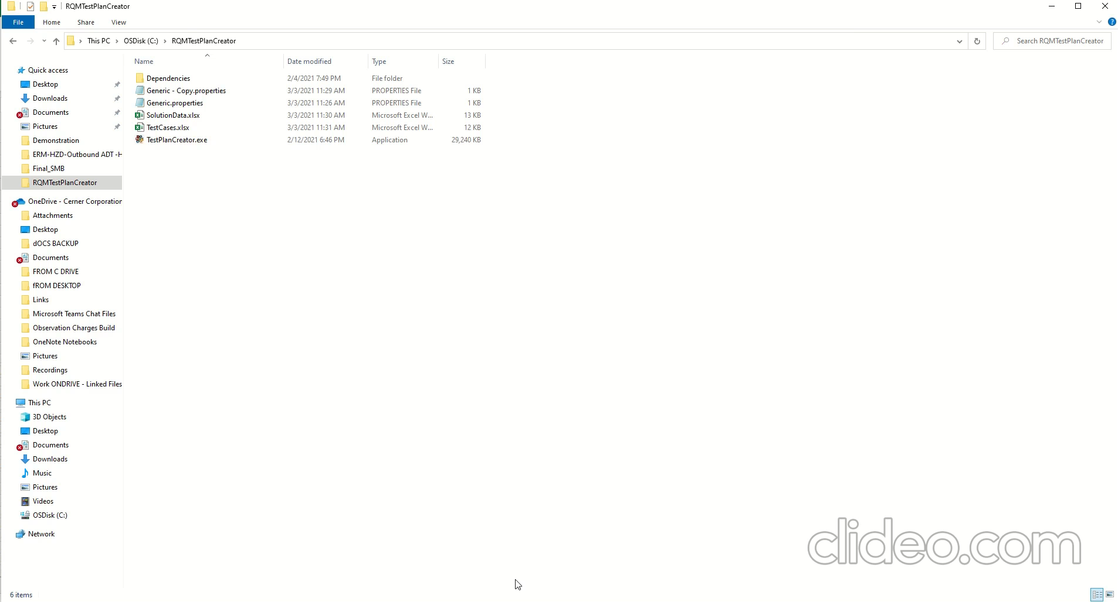
Demo Video

Slide 7


